Slide 1

Welcome to PETSHARE

Slide 2

Hello!
I am Greg Arnold
I am here because I want to give everyone the opportunity to share and enjoy the love of dogs.

Slide 3
PETSHARE
Your Dog. My Dog. Share Dawg.

Slide 4

Your Dog. My Dog. Share Dawg.
Just like our message says, we encourage dog sharing, between you and people within your community.

Slide 5
Mobile App Purpose
PETSHARE unites dog owners with people within their community looking to temporarily care and love their dog.
Provides owner/sharer with a pet sitter
Easily accessible search for locals with dogs or locals looking for dogs
Bring locals together and create friendships
Provide great opportunities to sharees/borrowers

Slide 6
Mobile App Goal
Our purpose is to make connections between people who want to spend quality time with dogs and people who could use help with their own dogs.
Provides owners/sharers with a trusted pet sitter.
Make it easy to arrange walks, vet visits, feedings, or playtime.
Makes dog boarding and visiting easy.

Slide 7
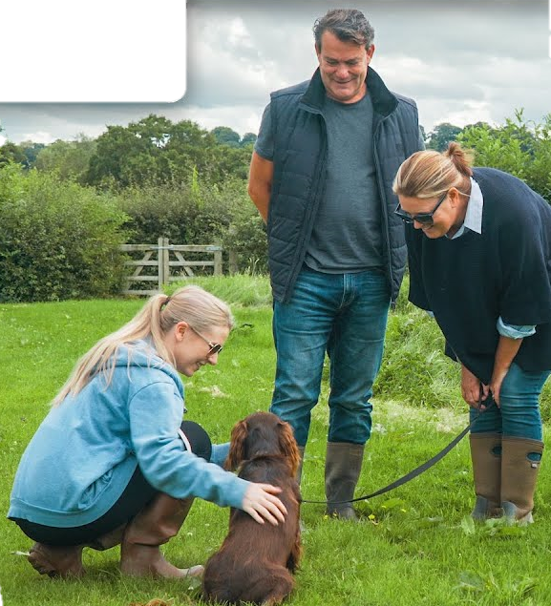
Target Audience
Local dog lovers are connected with each other to allow the owners to share their beloved pets with borrowers
PETSHARE

Slide 8

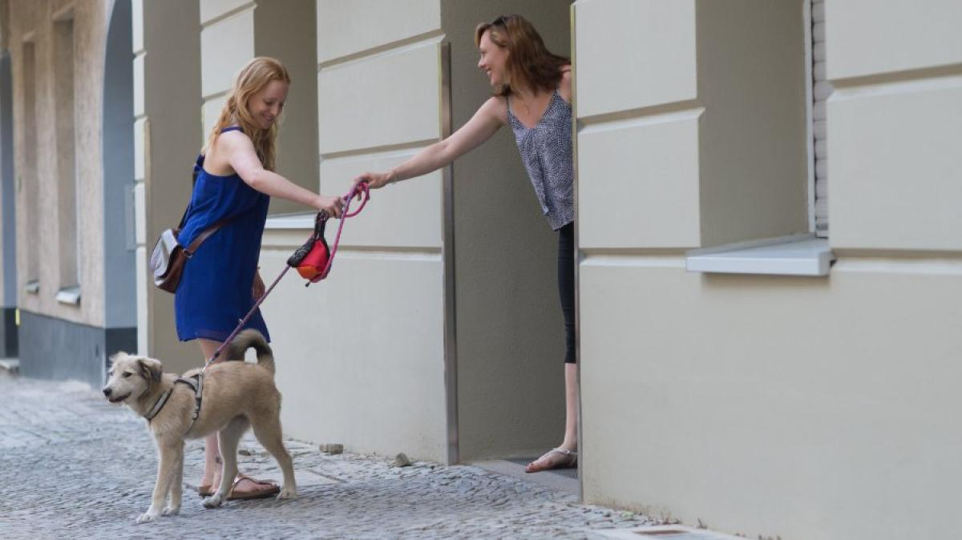
Want big impact? Use big image. (optional slide)
PETSHARE

Slide 9
Mobile App Features
Search Feature
Shows a search to start searching for a dog in your area, starting with the breed.
List of all different types of breeds that are close to the user within 50 miles.
Sharer Feature
Shows all of the dogs that they have available for sharing on a carousel.
Sharer can review the Sharee’s page and decide if they want to initiate a background check, which is charged to the Sharee.
Sharee Feature
Clicking email allows the Sharee (person requesting dog) to message the Sharer within the app.
Previous reviews of the Sharee with past K9’s and their about me passage
Videochat options prior to meetups

Slide 10
Competition Mapping
PETSHARE
Background checks performed
Genuinely caring dog lovers
Sharer and Sharee profiles with information about each
Agreement between both parties on any costs
Local Pet Boarding
Not as personal
Lots of dogs within facility
Minimal playtime
Expensive
Petsmart
Not as personal
No thoroughly trained employees
Lots of dogs within facility
Minimal playtime
Expensive
Rover.com
Can be Expensive
No established relationships
No background check performed

Slide 11
Risks/Weaknesses
Injury/Sickness to Pet
The owner’s pet could get sick on injured while in the custody of the borrower.
If the pet is already sick or injured, then it could get worse and create issues for the borrower.
Falsifying Information
If a borrower falsifies who they are, the dog, and potentitally the owner, could be in great danger.
It an owner falsifies facts about their dog, the borrower could get a dog with problems, or a dog they do not desire.

Slide 12
Development process
concept
(1-3 days)
second
last
The Sharee creates a profile to view local dogs in the area, by breed, that are available to borrow, then reach out to Sharer.
The Sharer reviews Sharee’s page and performs background check on Sharee prior to providing dog.
The Sharer and Sharee come to a mutual agreement on any costs, if any, of keeping the dog.

Slide 13
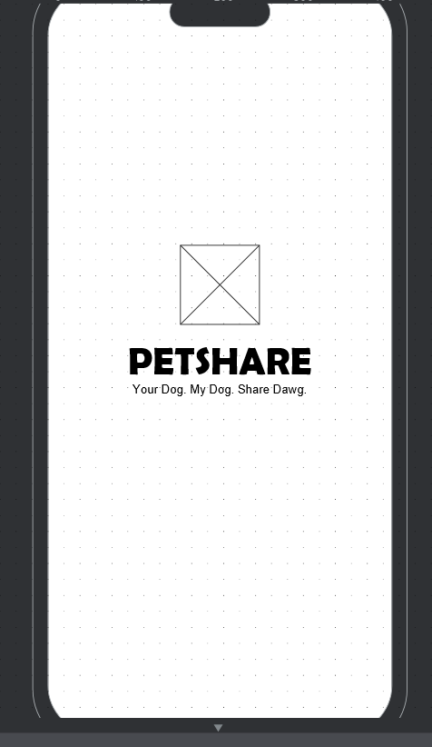
Splash/Home Page
Place wireframe/mock-up here
Splash Page that loads on app icon click, and timeout after 3 seconds. The box will contain a logo.

Slide 14
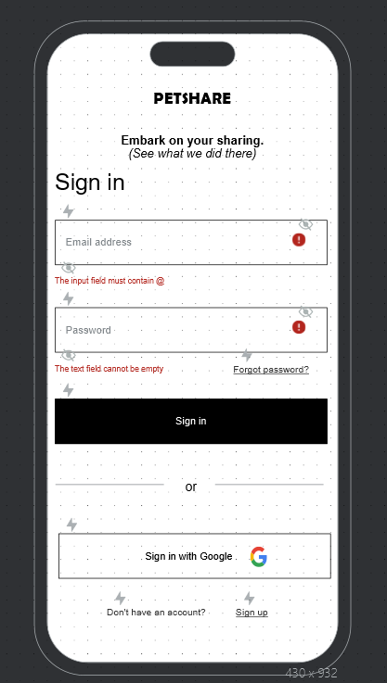
Sign-In Page
Place wireframe/mock-up here
The Sign in page which is next in order after the splash page timeout. If a user has an account, they can enter credentials here. Otherwise, they can Sign up at the bottom link that takes them to the Sign-up page below.

Slide 15
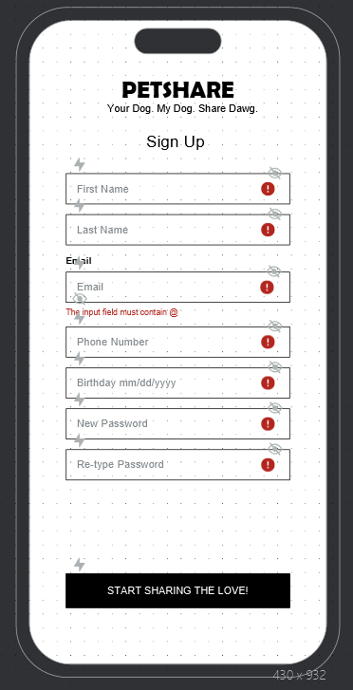
Sign-Up/Registration Page
Place wireframe/mock-up here
This is the Sign-up page for new users. The Start-Sharing button checks that the correct values are entered above for the fields, and once satisfied creates a new account in the database.

Slide 16
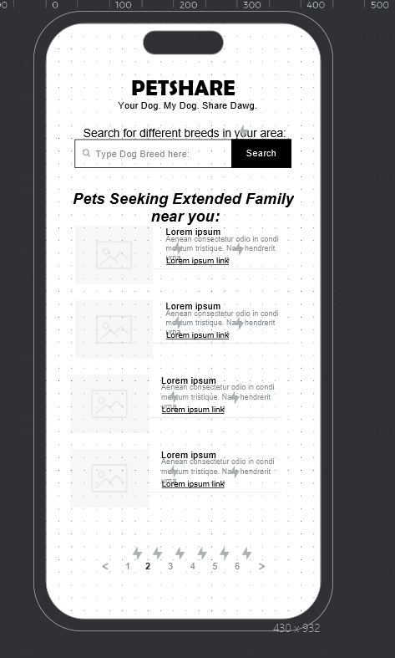
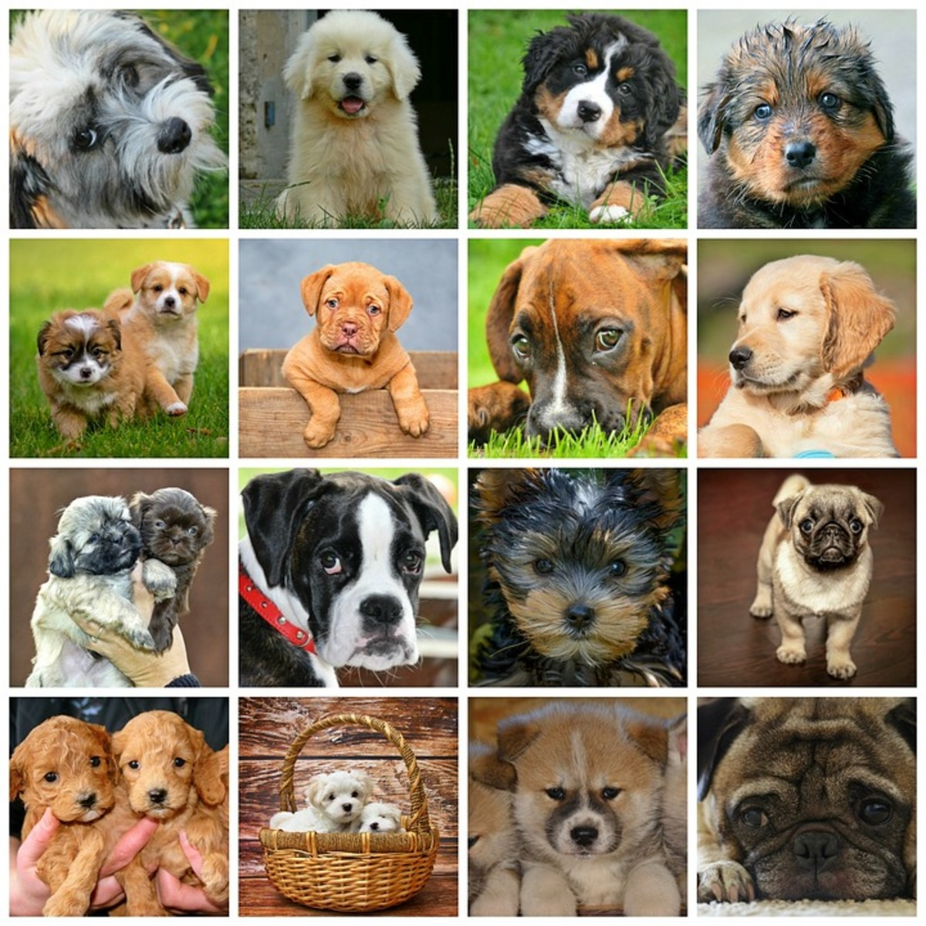
Search Page
Place wireframe/mock-up here
This is the page displayed after logging in or creating an account. It shows a search to start searching for a dog in your area, starting with the breed. Below the search bar is a list of all different types of breeds that are close to the user within 50 miles that are seeking someone to become extended family, which means they are up to be shared. The navigation bar shows more dogs in the 50-mile radius.

Slide 17
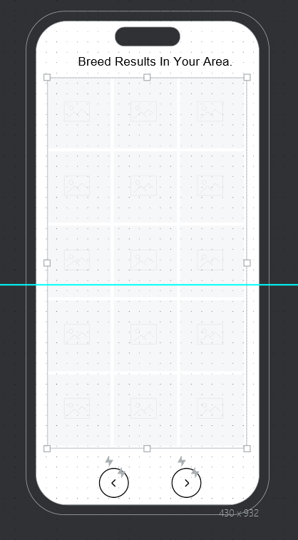
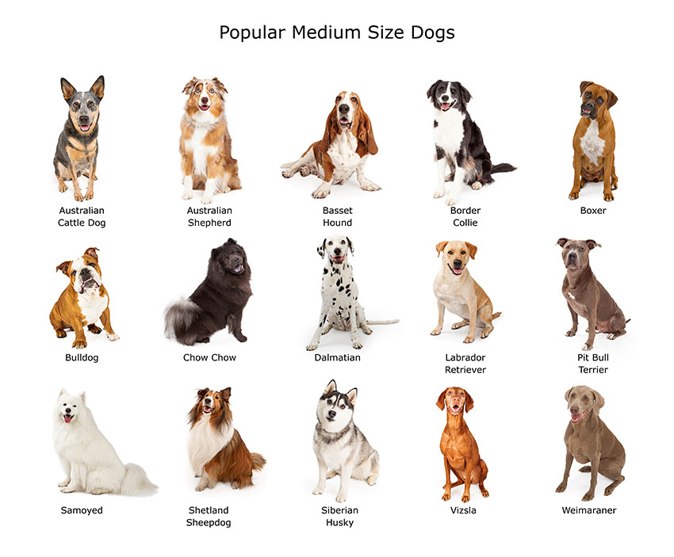
Search Results Page
Place wireframe/mock-up here
This is the result of the previous search page. It will show an image grid of the available dogs in the 50-mile radius that are the specific breed demanded. Each image will be linked to a dog in the database.

Slide 18
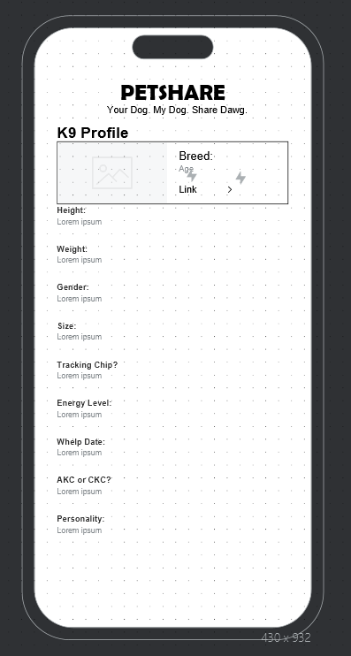
Dog Profile
Place wireframe/mock-up here
This page shows the dog profile default that shows up when you select a K9 from the database with the search feature. The fields on this page are from an abstract class of a dog and fill in via get methods that pull information from the database for the dog selected. If the link button is selected at the top, it will take the user to the owner of the K9’s profile.

Slide 19
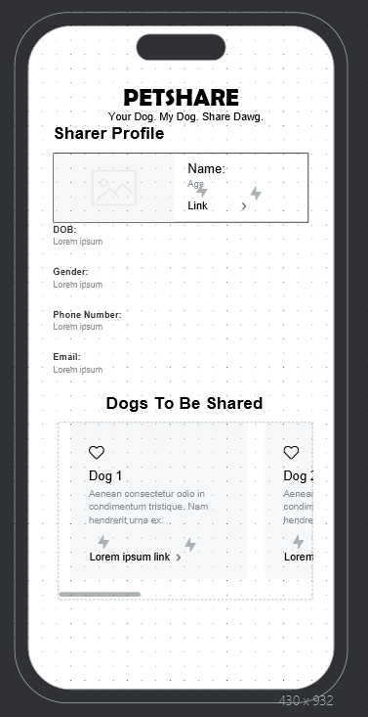
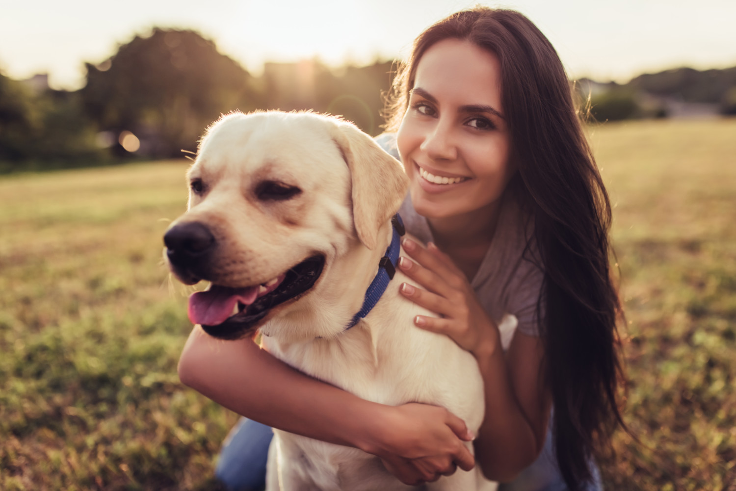
Sharer/Owner Page
Place wireframe/mock-up here
This page shows the owner of the K9 selected previously. It has all of the dogs that they have available for sharing on a carousel. Clicking email allows the Sharee (person requesting dog) to message the Sharer within the app. From there, the Sharer can review the Sharee’s page and decide if they want to initiate a background check, which is charged to the Sharee.

Slide 20
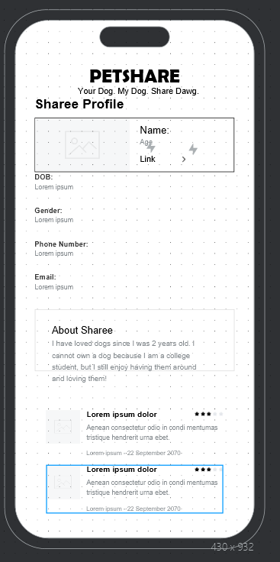

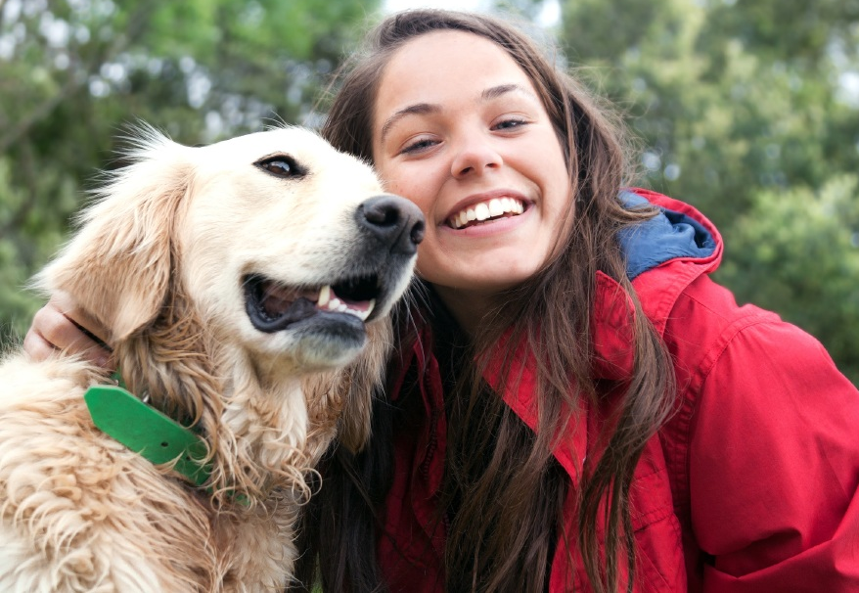
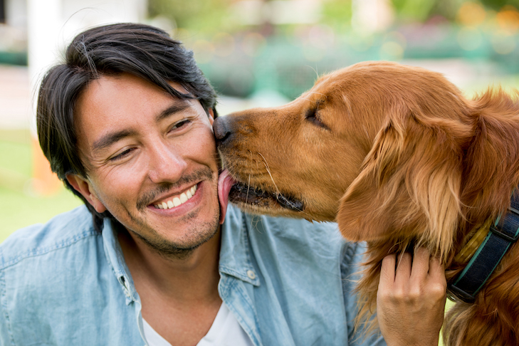
Sharee/Borrower Page
Place wireframe/mock-up here
This is the Sharee profile which can be viewed by the Sharer once the Sharee makes a request via email. Once the Sharer see’s the profile of the Sharee which includes, previous reviews of the Sharee with past K9’s and their about me passage, they can decide to call them or videochat them (videochat on their app of choice, because we currently don’t have videochat).

Slide 21
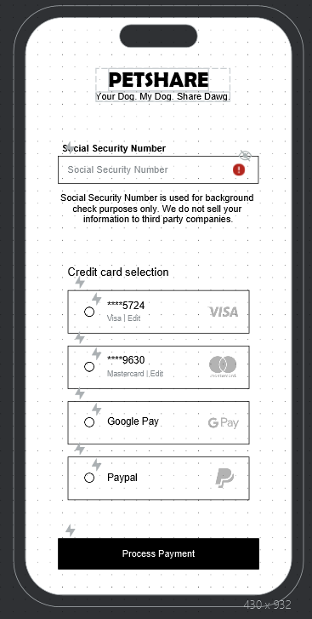
Secure Page
Place wireframe/mock-up here
This page is the page that the Sharee completes to start background check. Part of the money for the background check is sent to the app creator.

Slide 22
Thanks!
Any questions ?
You can find me at
grearn6019@students.ecpi.edu

